Slide 1
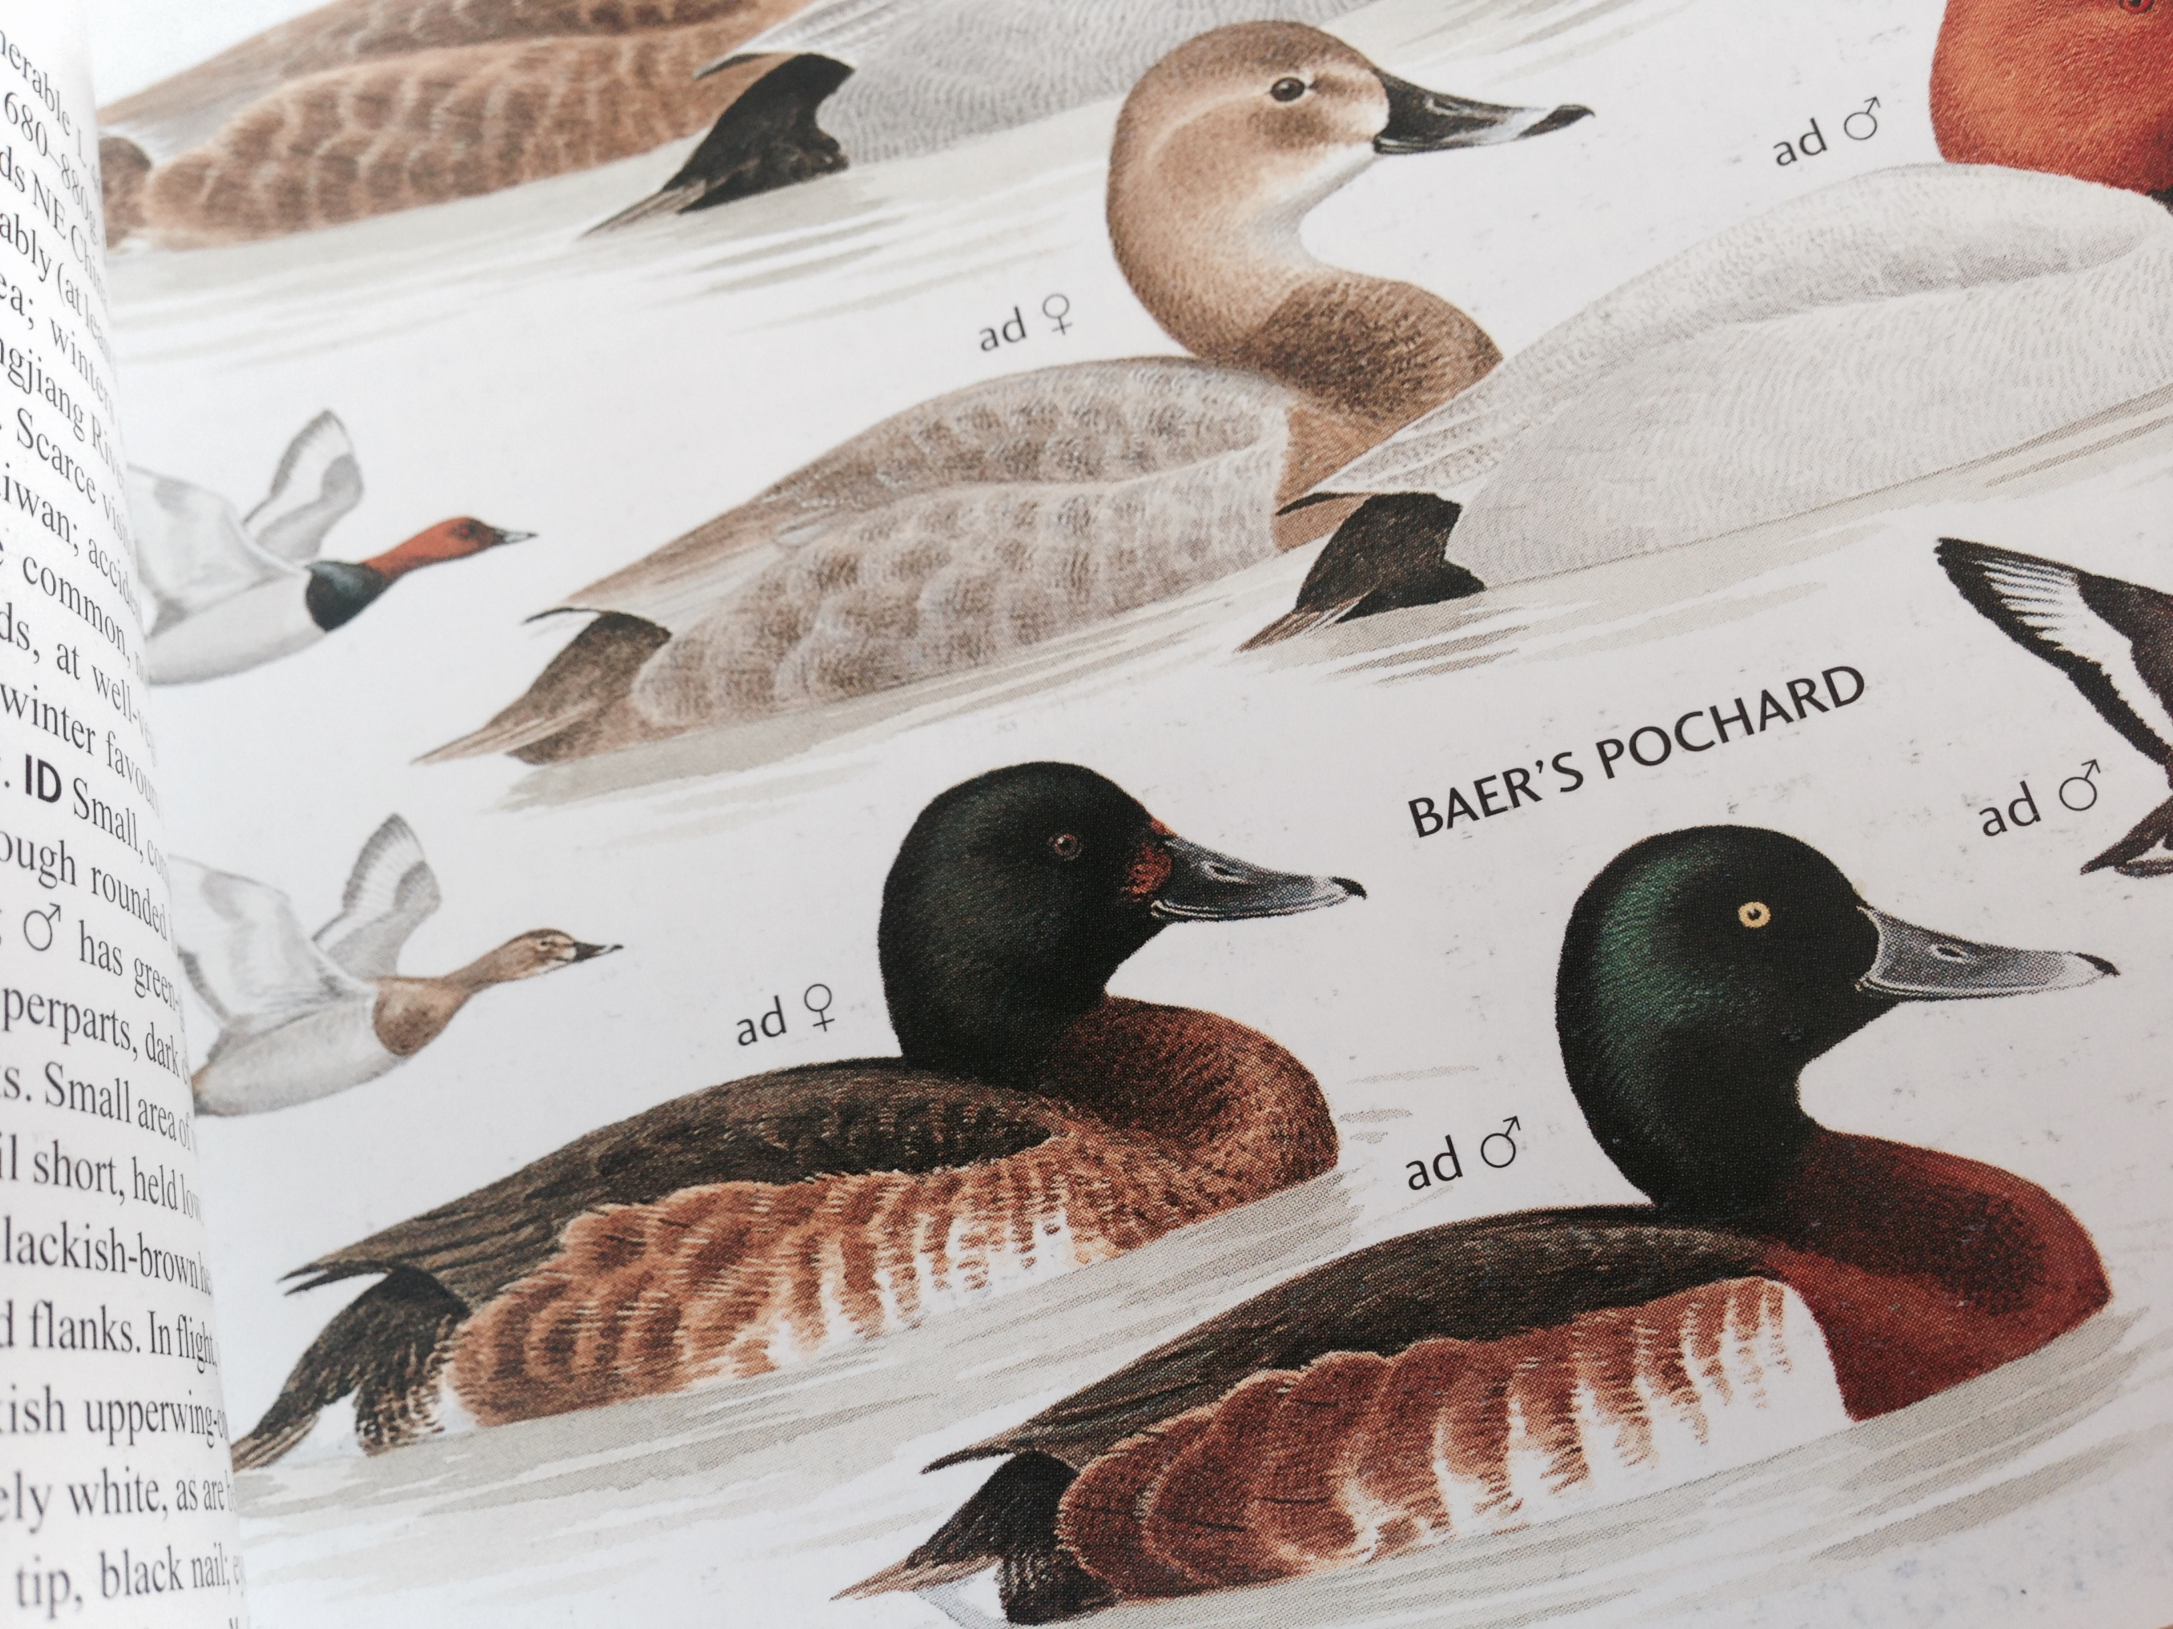
Baer’s Pochard (Aythya baeri)
Identification Guide
June 2015

Slide 2
Contents
General identification features
  Adult Males
  Adult Females
  Juveniles
Confusion Species
  Comparison of Baer’s Pochard and Ferruginous Duck

Slide 3
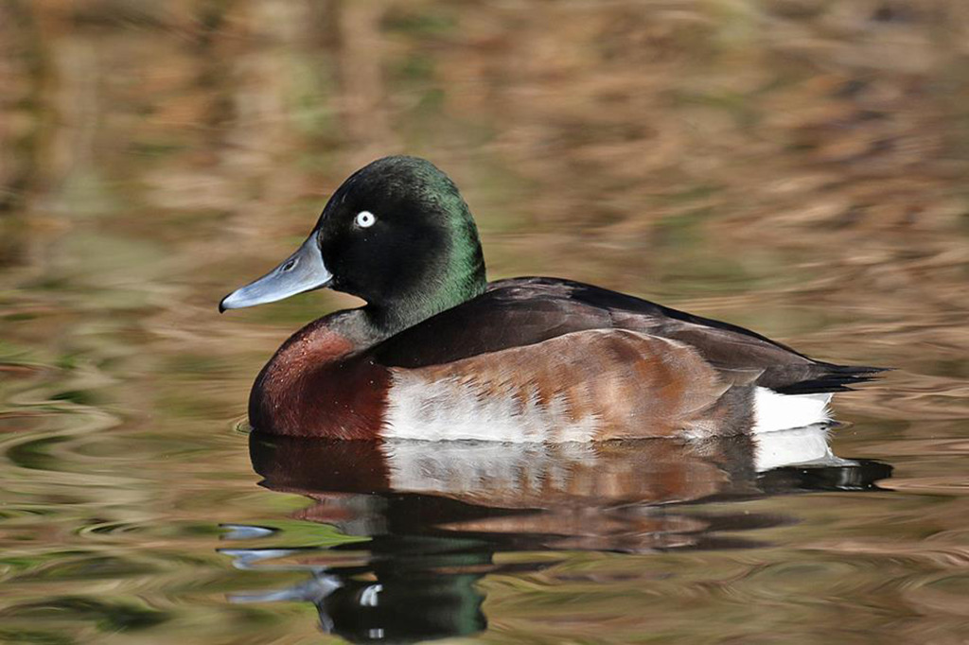
General Features
Structurally, Baer’s Pochard looks large-headed, has a relatively round crown (lacking the peak to the crown of Ferruginous Duck) and “feels” large-billed (an effect probably accentuated by the pale grey and blue tones to the bill, with black confined to the nail and the cutting edge).
The fore-flanks have obvious white patches, easy to see at all times above the water line, sometimes appearing as vertical ‘stripes’.
The head is dark green: not quite Mallard-green, but close. At some angles and in certain light, the green can just look dark. The breast is a warm reddish-brown, often looking fiery, or coppery in strong light, and sometimes appearing browner, adding to its “Mallard look”.
The rest of the upperparts are dark, in shade sometimes looking blackish, with a hint of warmer tips in fresh plumage, and perhaps a slight purpley gloss when worn. The vent is white, cleanly framed above and on the leading edge with dark.
The spread wing shows an extensive white wingbar (a feature shared with Ferruginous Duck). And like male Ferruginous Duck, the eye is also very pale, though usually yellowish-white or greenish-white rather than white or blue-white.

Slide 4
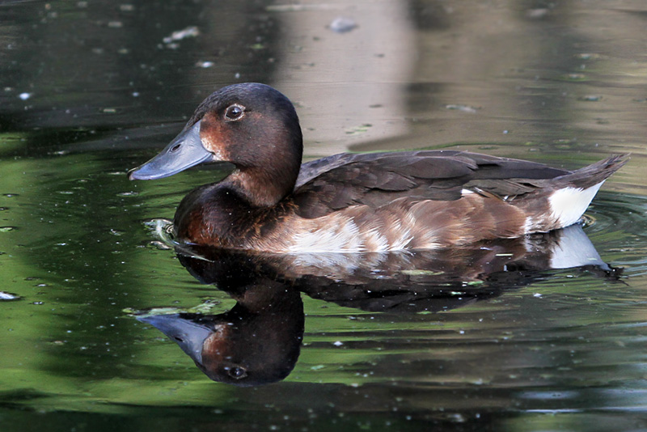
General Identification Features
(males and females)
White vent/undertail
Sturdy steely-blue coloured bill with small dark ‘nail’ at tip
Pale forward flanks contrasting with darker rear flanks

Slide 5
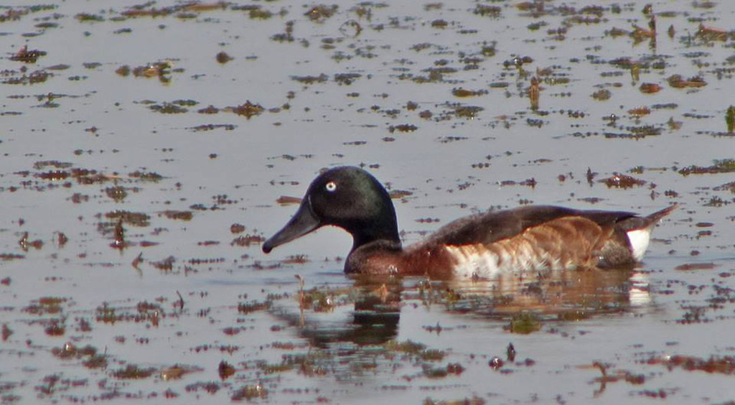
Adult Males
Dark green sheen on head contrasting with brownish breast
Yellowish-white or greenish-white eye (not white)
Clean white vent/undertail
Pale forward flanks, sometimes showing vertical ‘stripes’, contrasting with darker rear flanks

Slide 6
Adult females
“Ducks, Geese and Swans” describe the female thus: “superficially resembles male, but has dull brown head and chest, brown iris and subtle pale brown patch between bill and eyes”.
Females often look like a dull, dark version of the male, with the same head shape, same large-looking bill (though darker), same obvious white fore-flank patch and stripey flanks; similarly dark brown upperparts (though perhaps a shade paler than the male?); the same clean marked-off vent; and the same clean white wing-stripe.
Instead of a clean green head, the head looks darkly brownish-blackish-green, with a more or less obvious paler rusty patch on the lores, towards the bill base. Madge and Burn’s “Wildfowl” add that females “often” have “some whitish mottling on the throat” and that the iris is dark. It seems that the eye can appear more obviously bicolored when seen well or in strong light.

Slide 7
Adult females
Dark brown head, similar to colour of breast, sometimes with a hint of green
Dark eye
White vent/undertail
Pale forward flanks contrasting with darker rear flanks

Slide 8
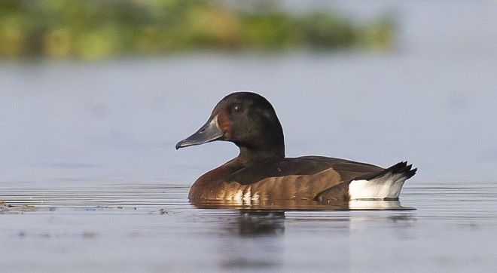
Adult female
Note white ‘stripes’ on forward flanks, dark eye, dark brown head with shallow angle from head to the sturdy bill.

Slide 9
Juveniles
Immature plumages are less well-known. Most Aythya (and therefore presumably Baer’s Pochard too) have a head and body moult during their first winter. Wing-feathers tend to be (largely) unmoulted, presumably creating moult contrast once a bird starts to mature. “Ducks, Geese and Swans” states that the immature looks “as adult female, but has russet brown abdomen”, a feature not shown in Madge and Burn. An immature male that has not yet started moult perhaps should have a russet brown abdomen (or some russet brown wash there) and look dark-eyed; and one that has started to moult should show white appearing on the vent; paleing (brown) eyes; green replacing brown on the head; and some moult contrast.
According to Madge and Burn, the juvenile “resembles female, but duller with head and neck dull buffish-brown, contrasting a little with the darker crown and hindneck and and reddish-brown breast; white of belly suffused brownish but white on fore-flanks relatively extensive. Assumes adult plumage during first autumn and winter.”
Other features to look for include pale tips to scapulars (on the back) and ‘spiky’ tail feathers.

Slide 10
Juveniles
There are very few images of juveniles available. Some video of a probable juvenile from the breeding grounds, taken in July 2014, can be seen at:
http://birdingbeijing.com/2014/07/28/juvenile-baers-pochard/

Slide 11
Eclipse and First-winter Males
Features of eclipse males and first-winter males are also less well-known.
One old source (“A Natural History of the Ducks: Plectropterinae, Dendrocygninae, Anatinae” by John Charles Phillips, 1922) apparently states that “Males in captivity did not “go off” in colour to any appreciable extent when in eclipse; although they assume a rusty facial patch and get some white mottling on the breast.”
At this time also the white appears to “fade off the flanks in both sexes”
Another source, Ducks, Geese and Swans (edited by Janet Kear and published by the Oxford University Press in 2005) notes that at least some male Baer’s Pochard are in nuptial plumage (=breeding plumage) in August.

Slide 12
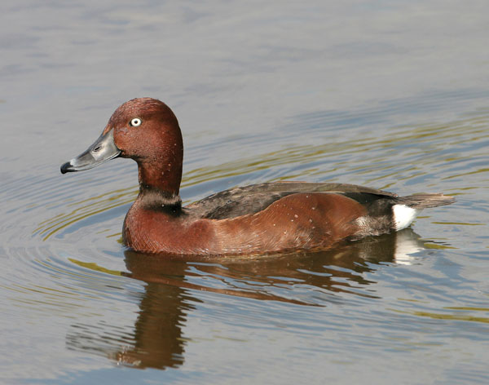
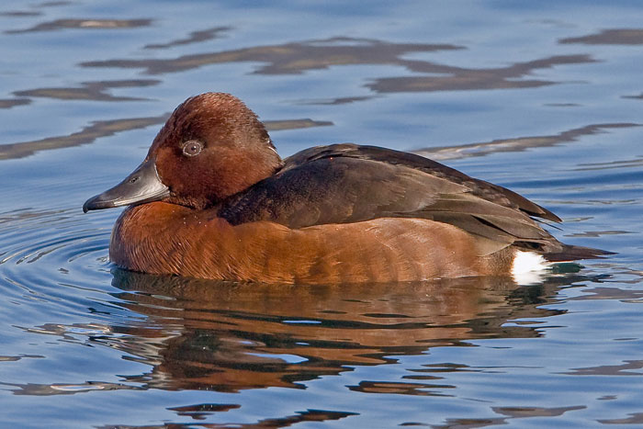
Confusion Species
Ferruginous Duck (Aythya nyroca)
Ferruginous Duck (female)
Ferruginous Duck (male)

Slide 13
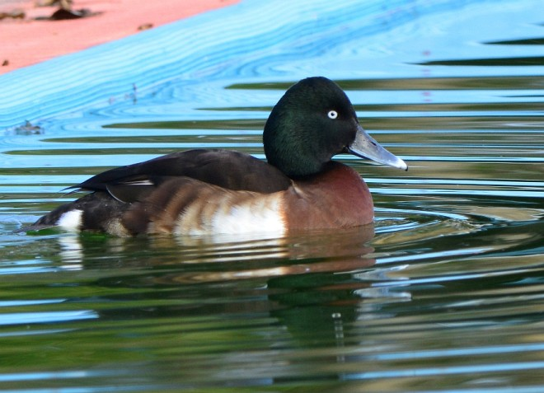
Male Baer’s Pochard v
Male Ferruginous Duck
Note: contrast between greenish-tinged head and more brown breast; pale fore-flanks, more yellow-white eye and tiny black ‘nail’ on bill.
Note: more consistent overall warm brown colour; more rounded head; larger dark ‘nail’ on bill, lack of pale on fore-flanks and whiter eye.

Slide 14
Female Baer’s Pochard v
Female Ferruginous Duck
Note: darker overall plumage of Baer’s (lacking reddish tones of Ferruginous); larger bill with smaller black ‘nail’; white ‘stripes’ on foreflanks.
Note: more ‘reddish’ brown plumage of Ferruginous, large dark ‘nail’ on bill, more ‘peaked’ crown and consistent colouration of flanks.

Slide 15
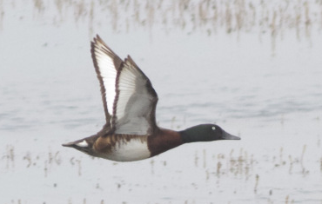
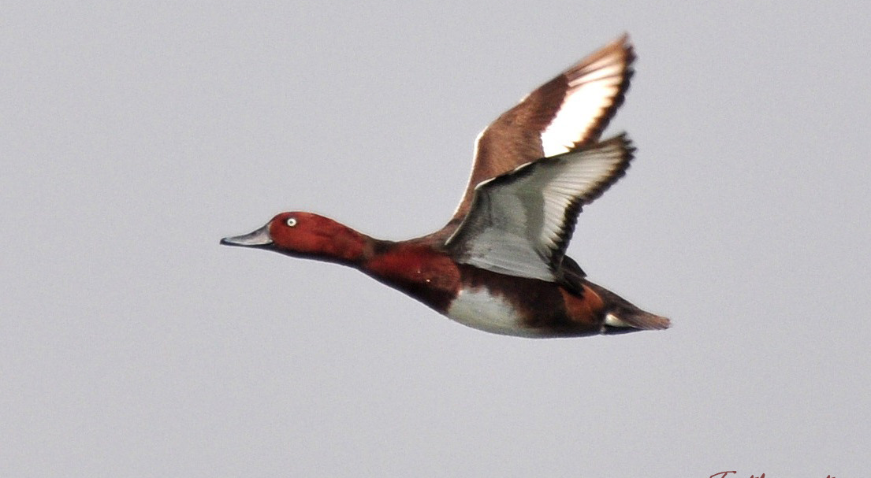
In Flight
Contrast between greenish head and brown neck/breast
Can look very similar in flight. Look out for contrast between the head and neck/breast, a good indicator of Baer’s Pochard. Ferruginous Duck is more consistent in colouration. White wing bar almost the same in both species.

Slide 16
References
This guide is based on best available information and will be updated as any new information comes to light. Comments welcome – please send email to birdingbeijing@gmail.com. Thank you.
Madge and Burn, “Wildfowl”, 1989
Kear, “Ducks, Geese and Swans”, 2005, Oxford University Press
Birds Korea blog: http://www.birdskoreablog.org/?p=14726
Birding Beijing http://birdingbeijing.com/2014/07/28/juvenile-baers-pochard/

